Slide 1
Spring Framework Core
Denis Slaveckij

Slide 2
Spring Framework
Most popular application development framework for enterprice Java.
Open source Java platform since 2003
Supports all major application servers and JEE standards
Handles the infrastructure so focus can be on application

Slide 3

Inversion of control vs Dependency injection
IoC is a generic term meaning rather than having the application call the methods in a framework, the framework calls implementations provided by the application.
DI is a form of IoC, where implementations are passed into an object through constructors/setters/service lookups, which the object will 'depend' on in order to behave correctly.

Slide 4
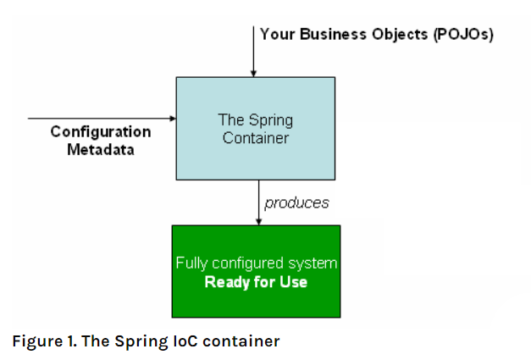
IoC Container
The org.springframework.context.ApplicationContext interface represents the Spring IoC container and is responsible for instantiating, configuring, and assembling the beans.
ClassPathXmlApplicationContext
FileSystemXmlApplicationContext

Slide 5
Configuration Metadata
Annotation-based configuration: Spring 2.5 introduced support for annotation-based configuration metadata.
Java-based configuration: Starting with Spring 3.0, many features provided by the Spring JavaConfig project became part of the core Spring Framework. Thus, you can define beans external to your application classes by using Java rather than XML files. To use these new features, see the @Configuration, @Bean, @Import, and @DependsOn annotations.

Slide 6
Bean Overview
A package-qualified class name: typically, the actual implementation class of the bean being defined.
Bean behavioral configuration elements, which state how the bean should behave in the container (scope, lifecycle callbacks, and so forth).
References to other beans that are needed for the bean to do its work. These references are also called collaborators or dependencies.
Other configuration settings to set in the newly created object — for example, the size limit of the pool or the number of connections to use in a bean that manages a connection pool.
Notes:
services.xml
XmlBasedApplicationContextTest:shouldLoadContext

Slide 7
Bean Naming
Good naming
accountManager,
accountService,
userDao,
loginController
With component scanning in the classpath, Spring generates bean names for unnamed components, following the rules described earlier: essentially, taking the simple class name and turning its initial character to lower-case. However, in the (unusual) special case when there is more than one character and both the first and second characters are upper case, the original casing gets preserved. These are the same rules as defined by java.beans.Introspector.decapitalize (which Spring uses here).
Notes:
XmlBasedApplicationContextTest:beanNames

Slide 8
The bean definition
Property | Explained in…​
Class | Instantiating Beans
Name | Naming Beans
Scope | Bean Scopes
Constructor arguments | Dependency Injection
Properties | Dependency Injection
Autowiring mode | Autowiring Collaborators
Lazy initialization mode | Lazy-initialized Beans
Initialization method | Initialization Callbacks
Destruction method | Destruction Callbacks
Notes:
XmlBasedApplicationContextTest.beanFactory

Slide 9
Dependencies injection
Constructor-based Dependency Injection
Setter-based Dependency Injection
Notes:
XmlBasedApplicationContextTest. dependenciesInjection

Slide 10
Constructor-based or setter-based DI?
Since you can mix constructor-based and setter-based DI, it is a good rule of thumb to use constructors for mandatory dependencies and setter methods or configuration methods for optional dependencies. Note that use of the @Required annotation on a setter method can be used to make the property be a required dependency; however, constructor injection with programmatic validation of arguments is preferable.

Slide 11
Circular dependencies
https://docs.spring.io/spring/docs/5.2.3.RELEASE/spring-framework-reference/core.html#beans-dependency-resolution
MainApplication
Notes:
MainApplication (this will fail)
// @Autowired private BBean bBean; public ABean(BBean bBean) { this.bBean = bBean; }
Show the endpoint: http://localhost:8080/circular

Slide 12
Use interfaces for Beans?
Use interface if there are at least 2 implementations.
Use interface if new implementation is intended to be introduced.

Slide 13
Autowiring modes
Mode | Explanation
no | (Default) No autowiring. Bean references must be defined by ref elements. Changing the default setting is not recommended for larger deployments, because specifying collaborators explicitly gives greater control and clarity. To some extent, it documents the structure of a system.
byName | Autowiring by property name. Spring looks for a bean with the same name as the property that needs to be autowired. For example, if a bean definition is set to autowire by name and it contains a master property (that is, it has a setMaster(..) method), Spring looks for a bean definition named master and uses it to set the property.
byType | Lets a property be autowired if exactly one bean of the property type exists in the container. If more than one exists, a fatal exception is thrown, which indicates that you may not use byType autowiring for that bean. If there are no matching beans, nothing happens (the property is not set).
constructor | Analogous to byType but applies to constructor arguments. If there is not exactly one bean of the constructor argument type in the container, a fatal error is raised.
Notes:
XmlBasedApplicationContextTest. autowired

Slide 14
Bean scopes
Scope | Description
singleton | (Default) Scopes a single bean definition to a single object instance for each Spring IoC container.
prototype | Scopes a single bean definition to any number of object instances.
request | Scopes a single bean definition to the lifecycle of a single HTTP request. That is, each HTTP request has its own instance of a bean created off the back of a single bean definition. Only valid in the context of a web-aware Spring ApplicationContext.
session | Scopes a single bean definition to the lifecycle of an HTTP Session. Only valid in the context of a web-aware Spring ApplicationContext.
application | Scopes a single bean definition to the lifecycle of a ServletContext. Only valid in the context of a web-aware Spring ApplicationContext.
websocket | Scopes a single bean definition to the lifecycle of a WebSocket. Only valid in the context of a web-aware Spring ApplicationContext.
Notes:
XmlBasedApplicationContextTest.beanScopes

Slide 15
Dependencies Injection
Lazy-initialized Beans
Configuration loading
Notes:
Lazy-initialized Beans
XmlBasedApplicationContextTest.shouldLoadLazyBean
XmlBasedApplicationConfigurationTest

Slide 16
Bean lifecycle
Lifecycle Callbacks
ApplicationContextAware and BeanNameAware
Using @PostConstruct and @PreDestroy
https://docs.spring.io/spring/docs/5.2.3.RELEASE/spring-framework-reference/core.html#beans-factory-lifecycle
https://docs.spring.io/spring/docs/5.2.3.RELEASE/spring-framework-reference/core.html#beans-factory-extension
Notes:
Run MainApplication with lifeCycle profile

Slide 17
Annotation based context and Component scanning
Annotation based context
Component scanning
Stereotypes
@Repository,
@Service,
@Controller
@Component
Fine-tuning Annotation-based Autowiring with Qualifiers
Notes:
AnnotationBasedApplicationContextTest
ScannedApplicationContextTest
@Autowired @Qualifier("googleProvider") private Provider provider;
And run MainApplication

Slide 18
Annotation based DI
As of Spring Framework 4.3, an @Autowired annotation on such a constructor is no longer necessary if the target bean defines only one constructor to begin with. However, if several constructors are available, at least one must be annotated with @Autowired in order to instruct the container which one to use.
Notes:
Discuss about not needed @Autowired constructor which saw in some projects

Slide 19
Java-based Container Configuration
Basic Concepts:
@Bean
@Configuration
Profiles
Notes:
ConfigurationBasedApplicationContextTest

Slide 20
Other Spring Core Features
Resource loading
Validation
Spring expression language
AOP with Spring
https://docs.spring.io/spring/docs/5.2.3.RELEASE/spring-framework-reference/core.html#spring-core
Notes:
ResourceLoadingTest
Show annotations in wupertal project if time is left.

Slide 21
Questions and Answers

